Slide 1
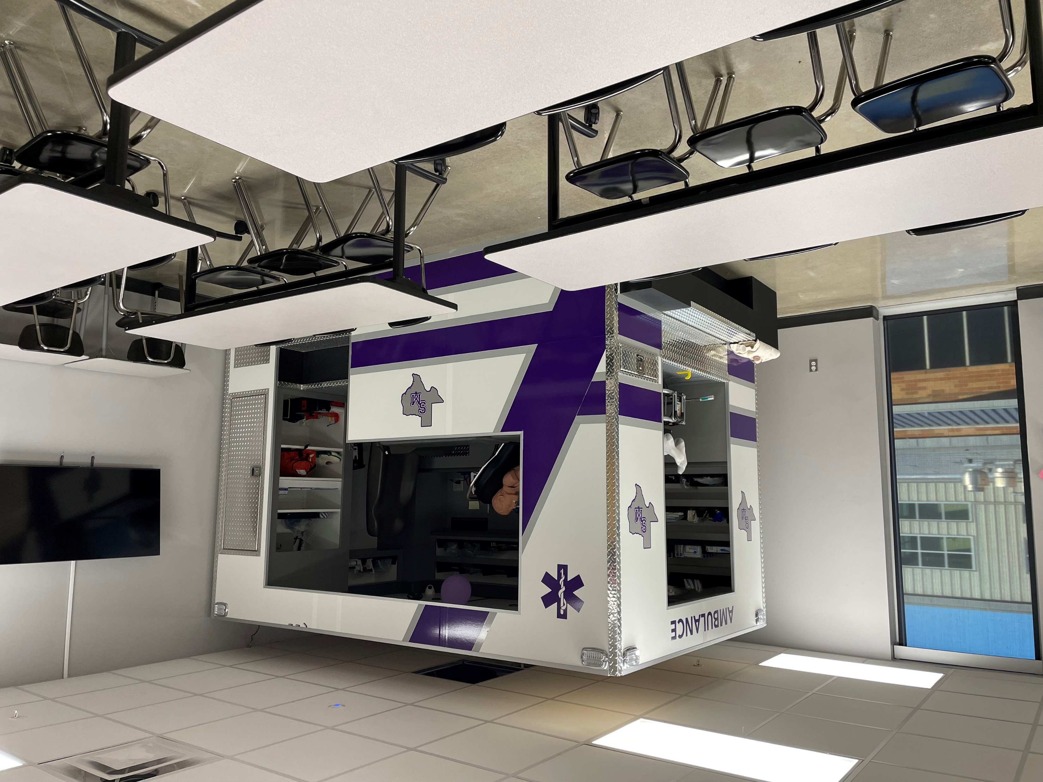
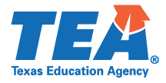
Healthcare Diagnostics
Statewide Program of Study
Health Science Career Cluster
The Health Science Career Cluster focuses on planning, managing, and providing therapeutic services, diagnostics services, health informatics, support services, and biotechnology research and development. To pursue a career in the health science industry, students should learn to reason, think critically, make decisions, solve problems, communicate effectively, and work well with others.
The Healthcare Diagnostics program of study introduces students to occupations and education opportunities related to performing complex medical laboratory tests for the diagnosis, treatment, and prevention of disease. This program of study may also include exploration into the opportunities associated with blood laboratories as well as radiologic technology and ultrasound technology.
Work-Based Learning and
Expanded Learning Opportunities
Secondary Courses for High School Credit
1 Principles of Health Science
2 Medical Terminology
3 Health Sci. Theory/Health Sci. Clinical
Anatomy and Physiology
4 (may select second Health Sci. Program)
Exploration Activities | Work-Based Learning Activities
Participate in Health Occupation Students of America | Perform clinical rotations at a community wellness center, hospital, assisted living, nursing home
Industry-Based Certifications
Medical Assistant
Postsecondary Opportunities
Associates Degrees
Nuclear Medical Technology/Technologist
Magnetic Resonance Imaging (MRI) Technology/Technician
Bachelor’s Degrees
Nuclear Medical Technology/Technologist
Medical Radiologic Technology/Science Radiation Therapist
Master’s, Doctoral, and Professional Degrees
Radiologist
Radiologic Technology/Science Radiographer
SMHS Health Science Clinic
Aligned Occupations
Occupations | Median Wage | Annual Openings | % Growth
Diagnostic Medical Sonographers | $69,909 | 495 | 35%
Phlebotomist | $30,597 | 1,442 | 36%
Nuclear Medicine Technologists | $75,962 | 91 | 13%
Radiologic Technologists | $55,494 | 1,196 | 21%
Magnetic Resonance Imaging Technologists | $68,661 | 217 | 21%
Successful completion of the Healthcare Diagnostics program of study will fulfill requirements of the Public Service or STEM endorsement if the math and science requirements are met. Revised – August 2022

Slide 2
Healthcare Diagnostics Course Information
COURSE NAME | SERVICE ID | PREREQUISITES | COREQUISITES
Principles of Health Science | 13020200 (1 credit) 6401 | None | None
Medical Terminology | 13020300 (1 credit) 6411 | Principles of Health Science | None
Health Science Theory/Health Science Clinical | 13020410 (2 credits) 6406 | Biology and Medical Terminology | None
Anatomy and Physiology | 13020600 (1 credit) 3266 | Biology and a second science credit | None
FOR ADDITIONAL INFORMATION ON THE HEALTH SCIENCE CAREER CLUSTER,
PLEASE CONTACT: CJ Odam, SMCISD CTE Coordinator cj.odam@smcisd.net
San Marcos CISD does not discriminate on the basis of race, color, national origin, sex, disability or age in its programs or activities and provides equal access to the Boy Scouts and other designated youth groups. The following person has been designated to handle inquiries regarding the nondiscrimination policies: Stephanie Munoz ; 631 Mill St, San Marcos, TX 78666 ; 512-393-6700 ; stephanie.munoz@smcisd.net
Further nondiscrimination information can be found at smcisd.net/cte

